Slide 1
Optimal Binary Search Tree
Dynamic Programming

Slide 2
Reference Videos
https://www.youtube.com/watch?v=uo93HY4UT-s (Explained with Example given in this PPT)
https://www.youtube.com/watch?v=xkQCsAW80CU

Slide 3
Optimal Binary Search Tree
Reference Link for Video
https://www.youtube.com/watch?v=g20bLO7ZHSs

Slide 4
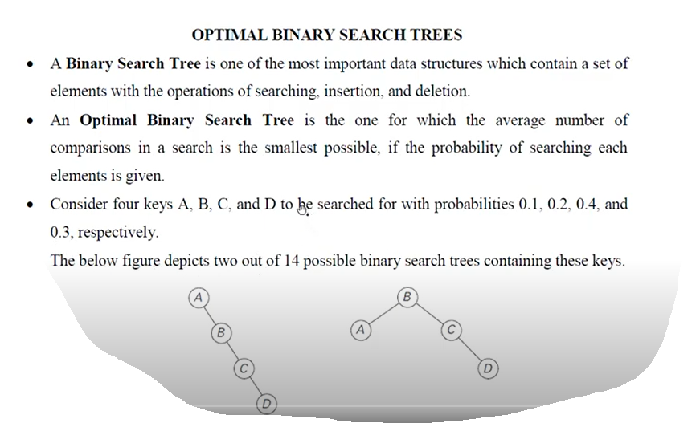

Slide 5
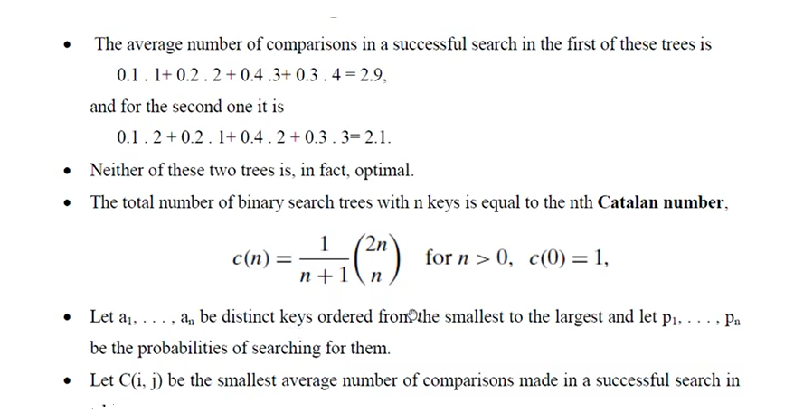

Slide 6
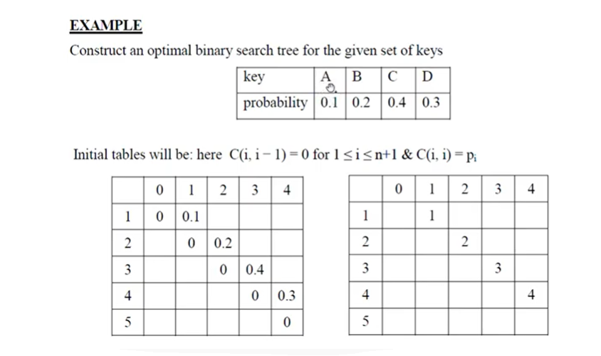

Slide 7
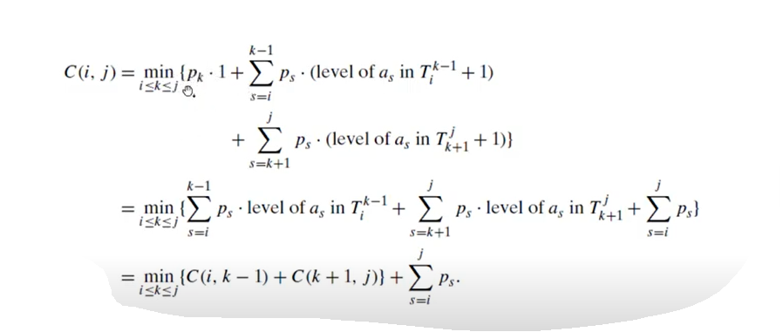

Slide 8
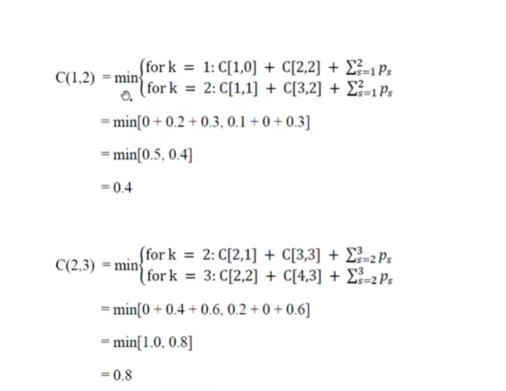

Slide 9
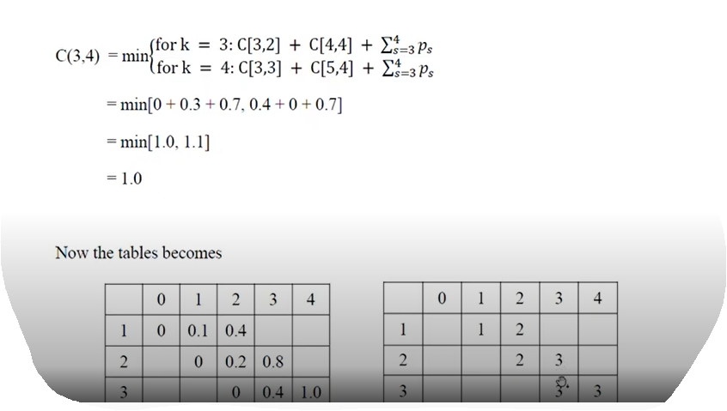

Slide 10
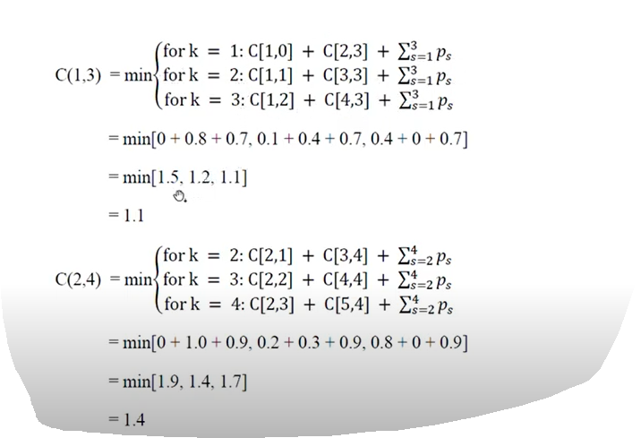

Slide 11
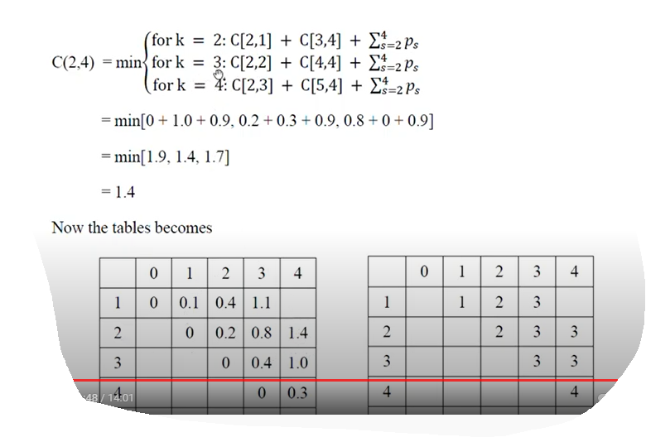

Slide 12
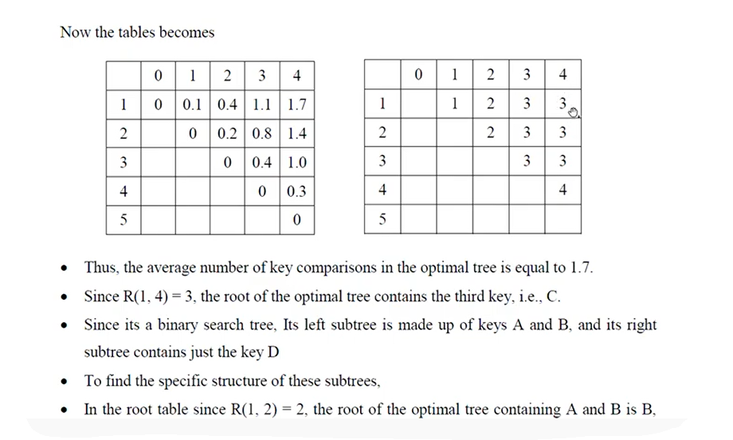

Slide 13
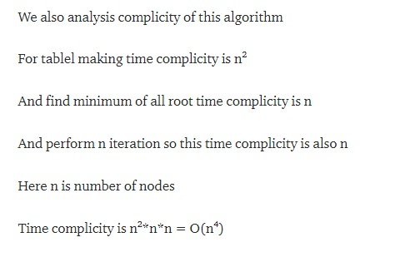

Slide 14
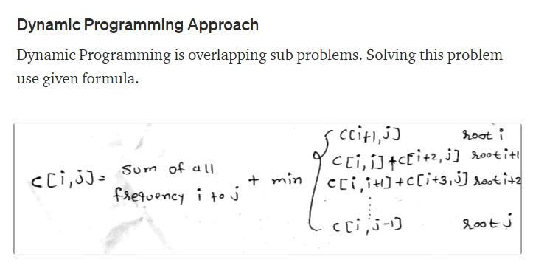
Optimal Binary Search Tree
Reference Link for Video
Another Example

Slide 15
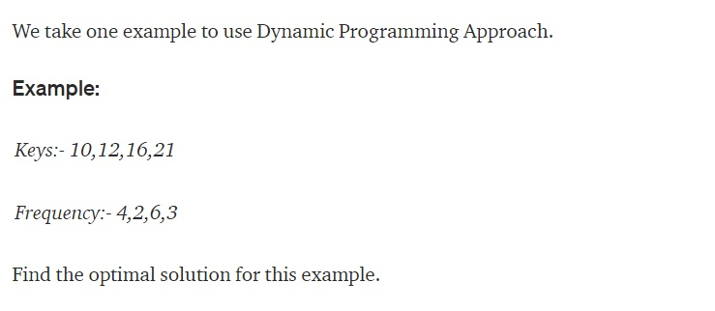

Slide 16
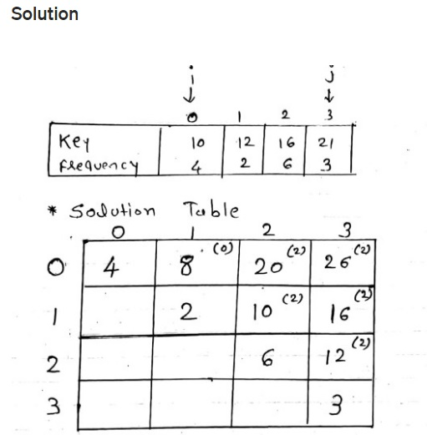

Slide 17
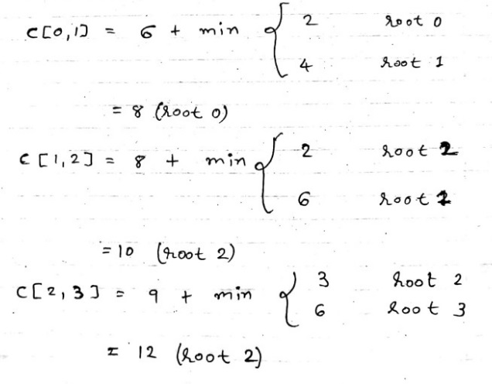

Slide 18
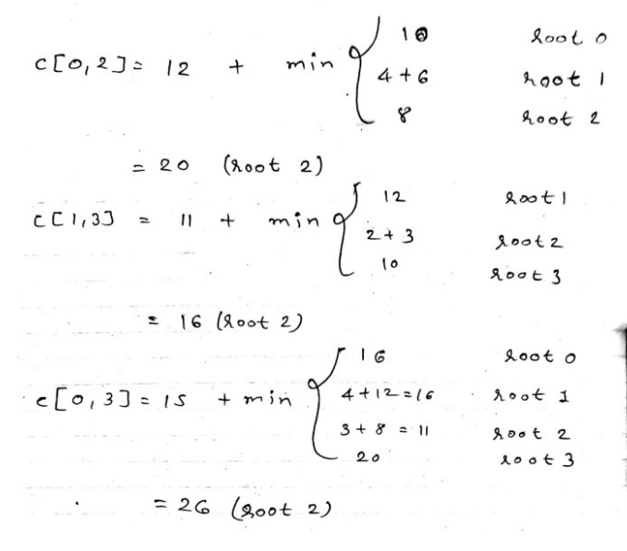

Slide 19
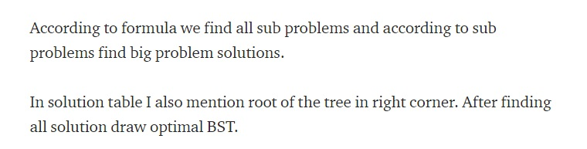

Slide 20
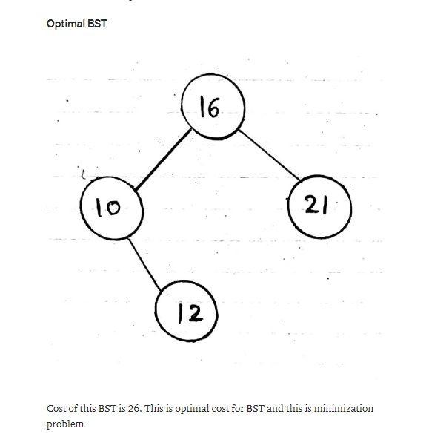

Slide 21
